Slide 1
Natural Disaster Prediction Project Analysis
Course Code: BMAT202P
WINTER SEMESTER 22-23

Slide 2
Agenda
Motivation & Problem Statement
Initial Screening
Setting up
Preprocessing the data
Correlation analysis
Regression analysis
Prediction from the model
Summary
Tech Stack

Slide 3

Motivation
Nature is characterized by a unique balance where all living creatures live in harmony with their surroundings. But whenever this balance is disturbed, we see the disastrous form of nature which wreaks havoc upon this world.
These disasters have always occurred throughout history but the current threat of climate change has greatly increased the risks.
By predicting natural disasters in advance, we can reduce the damage caused by them.

Slide 4

Problem Statement
Given an image/ video as input, develop a Machine Learning model to classify it as Cyclone, Earthquake, Flood or Wildfire using multinomial classification algorithms.

Slide 5
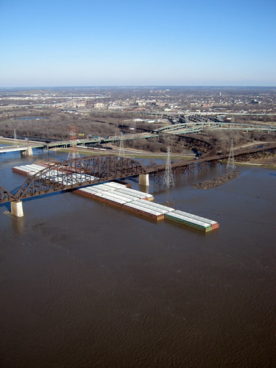
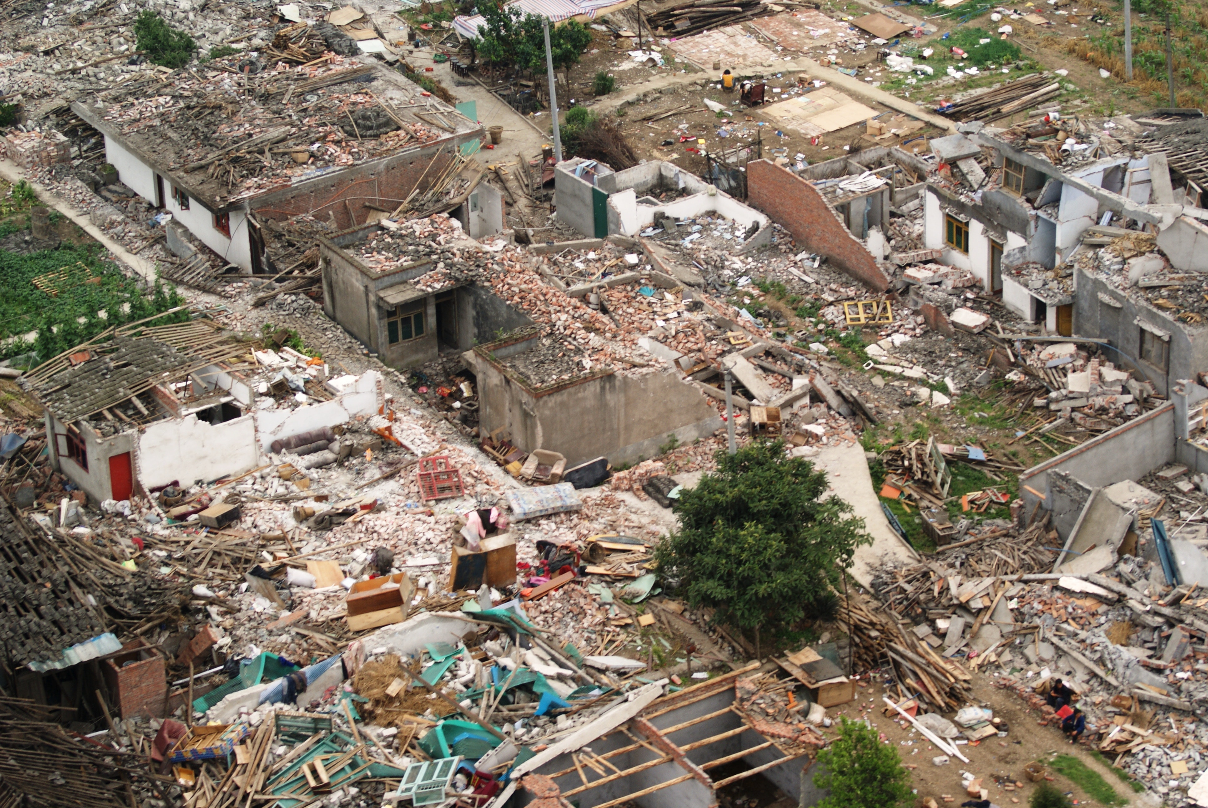
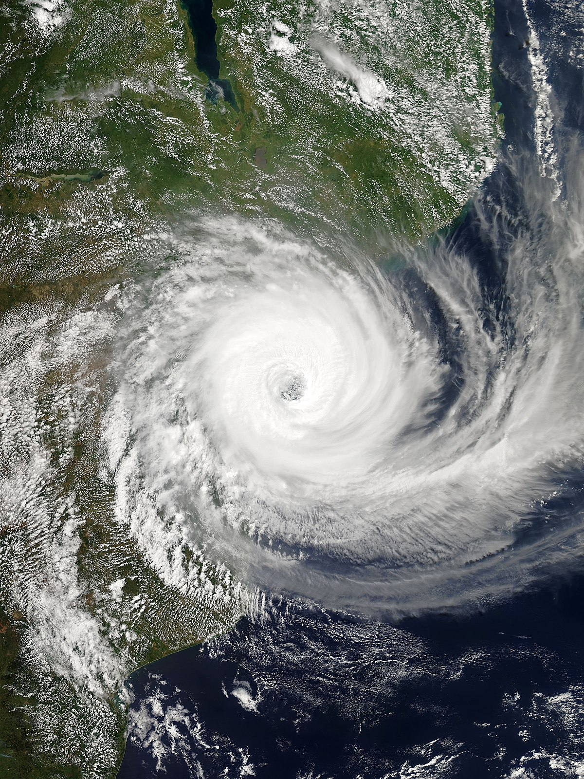
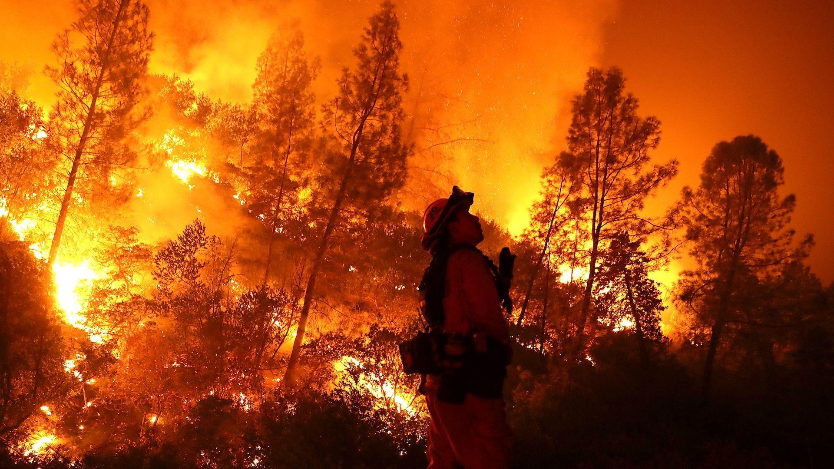
Initial Screening
Images were collected from Kaggle’s - Cyclone Wildfire Flood Earthquake Database
Number of image samples in each class is different.
Cyclone has 928 images
Earthquake has 1350 images
Flood has 1073 images
Wildfire has 1077 images
Duplicate images were deleted.
On observing the images, a pattern of colors was noted on the basis of which pixels were extracted to perform analysis on the data.

Slide 6





Tech Stack

Slide 7
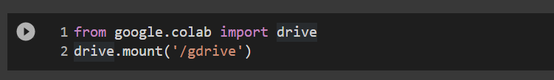
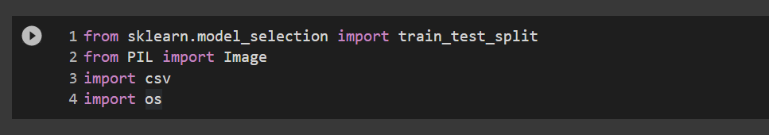
Setting up
Mount to google drive onto the Google colab environment
2. Import required libraries

Slide 8
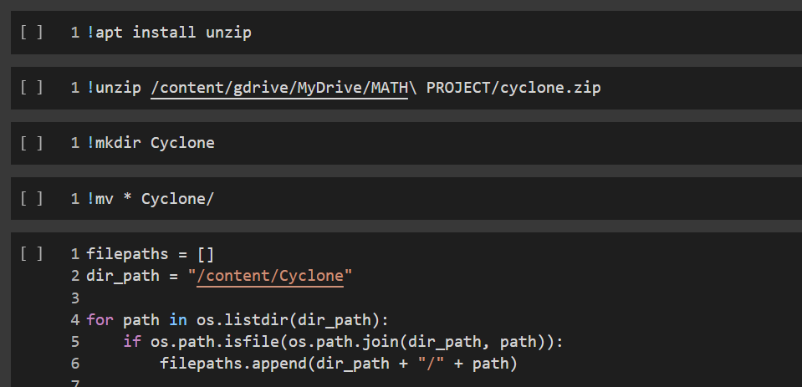
Setting up
3. Extract the files
Unzip the files from the required zip file. Create a folder to move all the unzipped files into. Store the paths of all the files in a list named filepaths

Slide 9
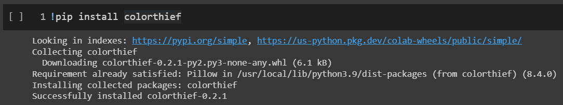
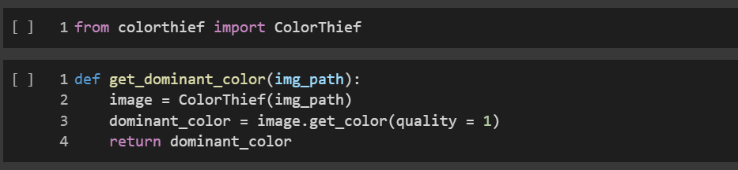
Preprocessing data
Get the dominant color from each image in the dataset

Slide 10
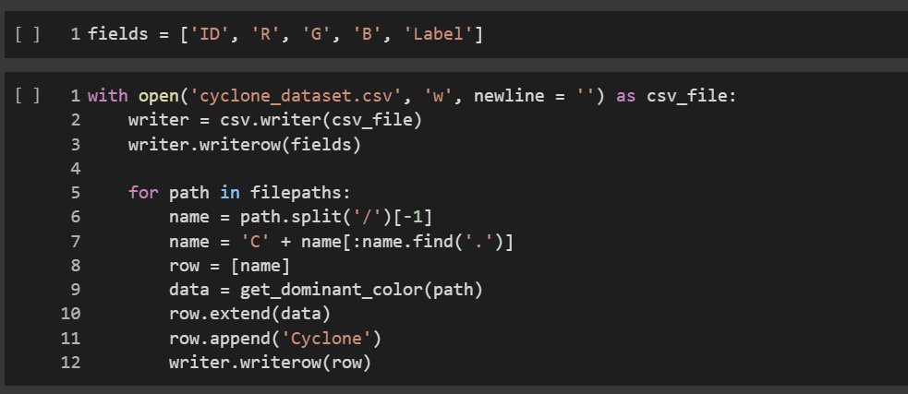
Preprocessing data
2. Create a csv file to store the dominant colors of each image in respective files.

Slide 11
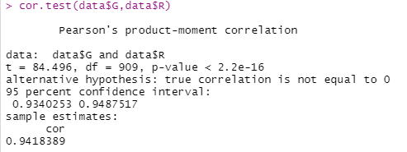
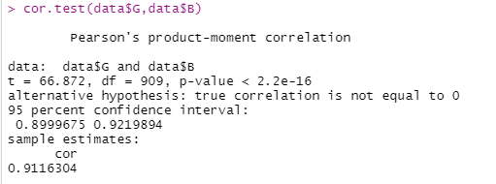
Correlation Analysis
CYCLONE
The correlation coefficient between G and R values for the cyclone dataset images is highly positively correlated. This suggests that as G increases R also increases.
The correlation coefficient between B and G values for the cyclone dataset images is highly positively correlated. This suggests that as B increases G also increases.

Slide 12
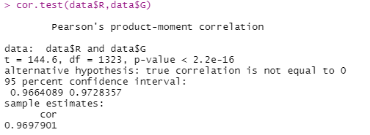
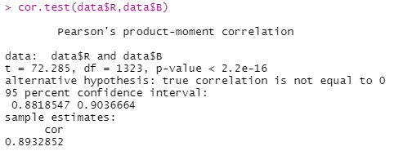
Correlation Analysis
B. EARTHQUAKE
The correlation coefficient between R and G values for the earthquake dataset images is highly positively correlated. This suggests that as R increases G also increases.
The correlation coefficient between B and R values for the earthquake dataset images is highly positively correlated. This suggests that as B increases R also increases.

Slide 13
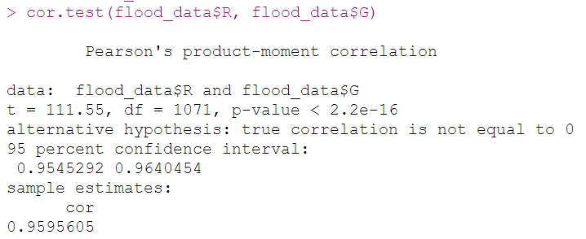

Correlation Analysis
C. FLOOD
The correlation coefficient between R and G values for the flood dataset images is highly positively correlated. This suggests that as R increases G also increases.
The correlation coefficient between B and G values for the flood dataset images is highly positively correlated. This suggests that as B increases G also increases.

Slide 14
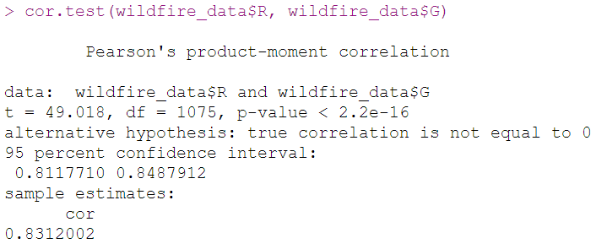

Correlation Analysis
D. WILDFIRE
The correlation coefficient between R and G values for the wildfire dataset images is moderately positively correlated.
This suggests that as R increases G also increases.
The correlation coefficient between B and G values for the wildfire dataset images is highly positively correlated. This suggests that as B increases G also increases.

Slide 15
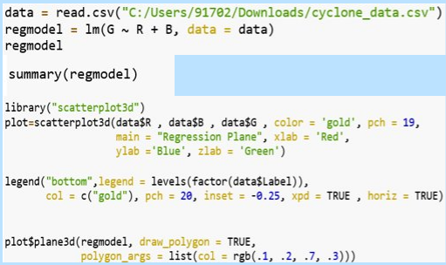
Regression Analysis
Regression analysis is a set of statistical methods used for the estimation of relationships between a dependent variable and one or more independent variables.

Slide 16
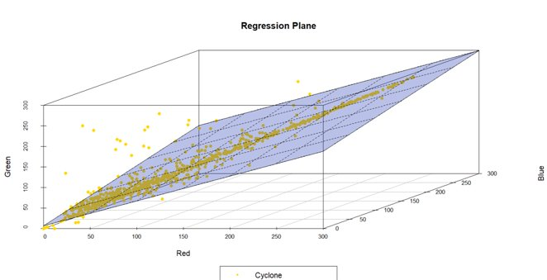
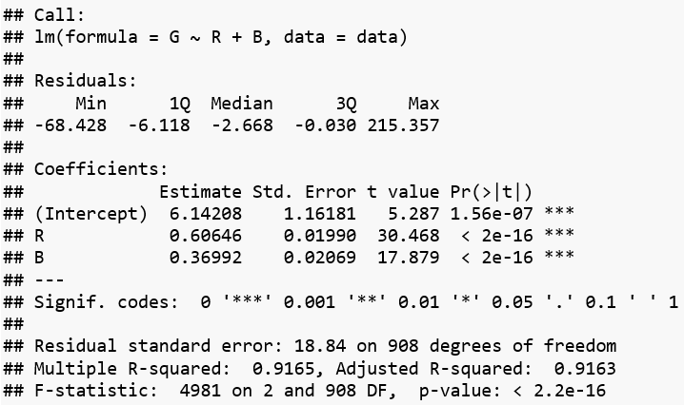
Regression Plane
CYCLONE
Regression line of G on R, B is
G = 0.6R + 0.37B + 6.14

Slide 17
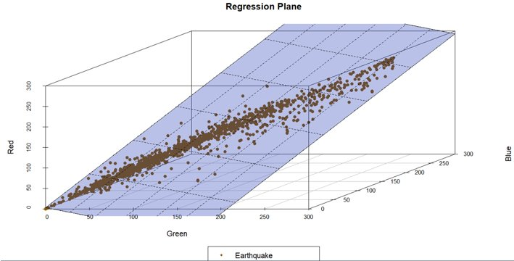
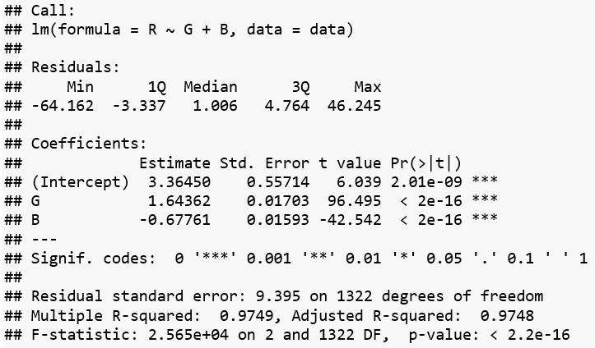
Regression Plane
B. EARTHQUAKE
Regression line of R on G, B is
R = 1.64G - 0.67B + 3.36

Slide 18
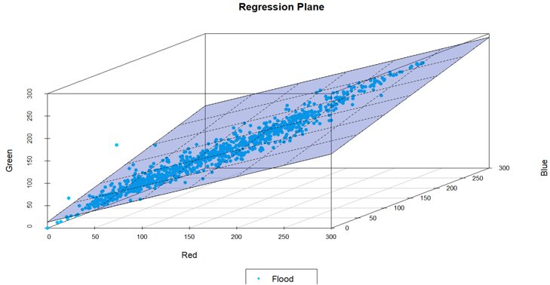
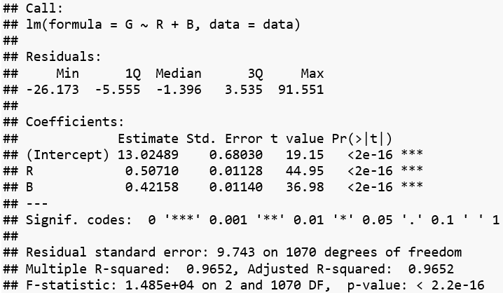
Regression Plane
C. FLOOD
Regression line of G on R, B is
G = 0.51R + 0.42B + 13.02

Slide 19
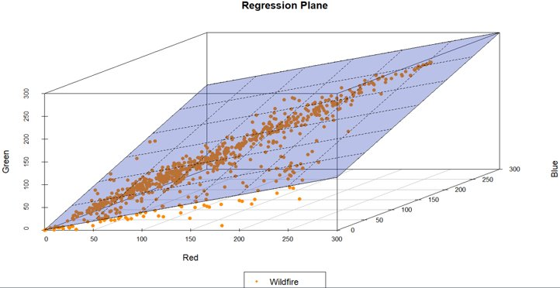
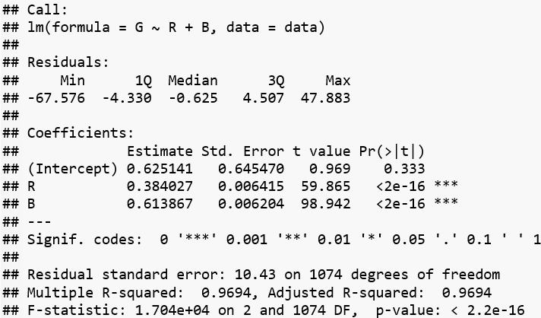
Regression Plane
D. WILDFIRE
Regression line of G on R, B is
G = 0.38R + 0.61B + 0.62

Slide 20
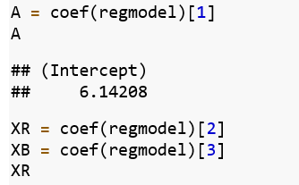
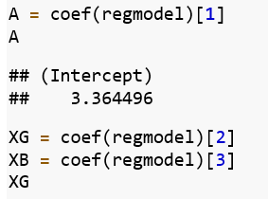
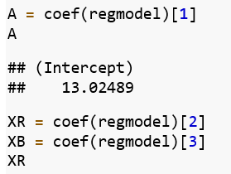
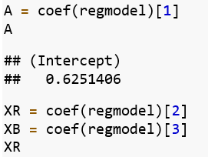
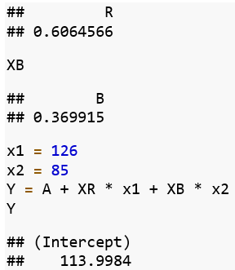
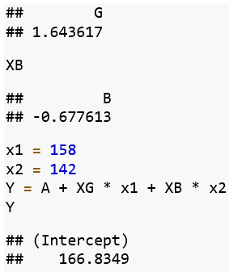
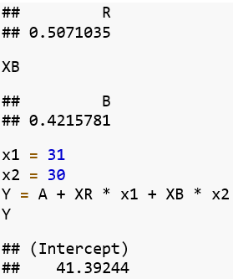
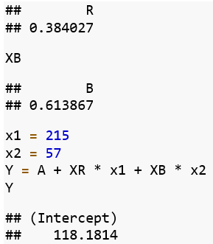
Prediction From The Model
For Cyclone the
predicted value is:
2) For Earthquake the predicted value is:
3) For Flood the predicted value is:
4) For Wildfire the predicted value is:
Actual value G = 112
Actual value R = 166
Actual value G = 40
Actual value G = 120

Slide 21





Project analysis slide 6
Summary
SCREENING
We observed 4000+ images in the dataset, removed redundant samples, and identified a pattern of colors for each label
IDEA
To design a machine learning model to detect natural disasters from images and videos.
IMPLEMENTATION
Converted qualitative data into quantitative data, and stored extracted data into csv files using Python
REVIEW
Predicted values of dependent variables from the regression line, analyzed their correctness, and performed hypothesis test for reduced model
ANALYSIS
Analyzed and understood the relation between variables that define a data point, to identify an appropriate model
BUILDING LINEAR MODEL
Constructed a multiple linear regression line for each label, visualized the data points and the regression plane obtained

Slide 22
References
Dataset - Cyclone Wildfire Flood Earthquake Database
https://www.kaggle.com/datasets/rupakroy/cyclone-wildfire-flood-earthquake-database?resource=download
Regression Analysis
https://rpubs.com/ranvirkumarsah/Intro2Regression
Plotting a plane in R
https://rpubs.com/ericroh/334817
Python Documentation – Python standard library 3.7
https://docs.python.org/3.7/library/index.html

Slide 23
Thank You

